Slide 1
Object Oriented Programming
Week 2
Abeer GAUHER
Email: abeer.gauher@nu.edu.pk
Office: CS BASEMENT 2, Office number 17

Slide 2
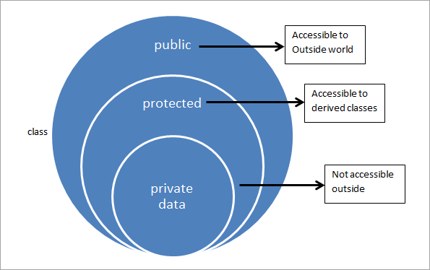
Information Hiding
It is hidden from the outside world.
It can only be manipulated by the object itself.
Simplifies the model by hiding implementation details.

Slide 3
Encapsulation (1st Principle of OOP)
Encapsulation is a process of wrapping of data and methods in a single unit.
It involves the bundling of data members and functions inside a single class.
Bundling similar data members and functions inside a class together also helps in data hiding.

Slide 4
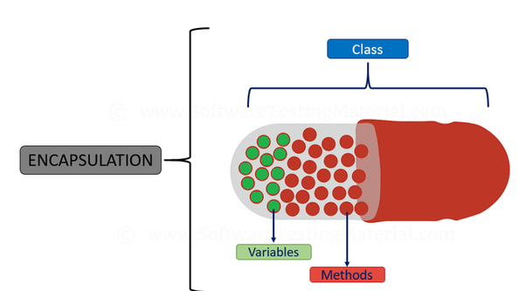
Real Life Example of Encapsulation

Slide 5
Real Life Example of Encapsulation
A Phone stores phone numbers in digital format and knows how to convert it into human-readable characters
We don’t know
How the data is stored
How it is converted to human-readable characters

Slide 6
ENCAPSULATION – ADVANTAGES
Simplicity and clarity
Low complexity
Better understanding

Slide 7
Abstraction in OOP (2nd Principle)
Abstraction is selecting data from a larger pool to show only the relevant details to the object.
Abstraction is a way to cope with complexity.
Principle of abstraction:
“Capture only those details about an object that are relevant to current perspective”

Slide 8
Example – Abstraction
Ali is a PhD student and teaches BS students
Attributes
- Name - Employee ID
- Student Roll No - Designation
- Year of Study - Salary
- CGPA - Age

Slide 9
Example – Abstraction
Student’s Perspective
Attributes
- Name - Employee ID
- Student Roll No - Designation
- Year of Study - Salary
CGPA - Age
Behavior
- Study - DevelopExam
- GiveExam - TakeExam
- PlaySports - Eat
- DeliverLecture - Walk

Slide 10
Example – Abstraction
Teacher’s Perspective
Attributes
- Name - Employee ID
- Student Roll No - Designation
- Year of Study - Salary
- CGPA - Age

Slide 11
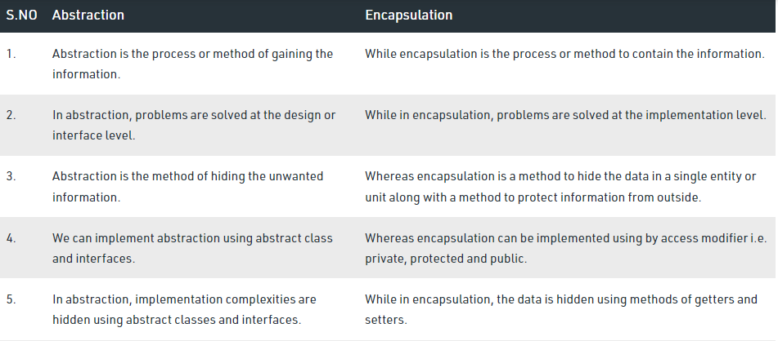

Slide 12
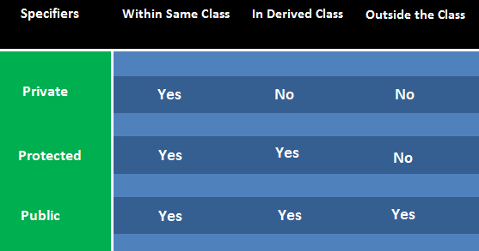
Access Specifiers
Public
Private
Protected

Slide 13
Syntax
class
{
private:
// private members and function
public:
// public members and function
protected:
// protected members and function
};

Slide 14
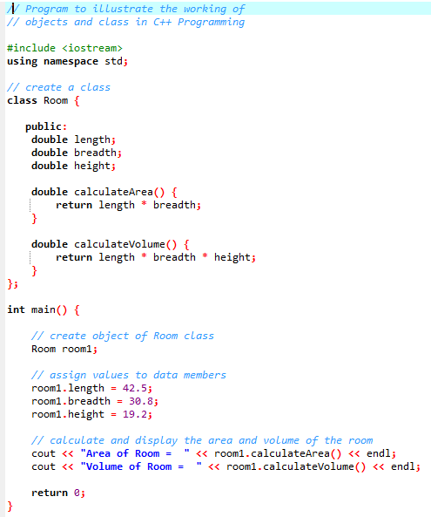

A Simple Class

Slide 15
Brain-Storming
Consider a world in which people can save money into a bank. There may be different banks (e.g. Bank Al-Habib, Allied Bank etc) and customers may have different activities with their banks.
• Write down the different kinds of objects which are involved in this “Personal banking” domain.
Customer
Consider a customer who can open bank accounts in a bank. Write down the list of attributes required to model the data components of a customer, (e.g. the name of the customer)
For each of these attributes:
• Would you model it as a class-level/object-level attribute and why?
• What will be the appropriate data type?
• Would you make this attribute visible to other objects and why?
• Would you hide this attribute from other objects and why?
• Write down the list of methods required to model the procedural component of a customer, i.e. Operations/ behavior that a customer can perform.

Slide 16
Q1) Write a C++ program to create a class to get and print details of a student.
- The details of the student includes the following:
Name, rollNo, total, perc
- The class contains two functions input and display that takes input from the student and displays the information using the display function.
Create a object of the class in the main function and call both the functions using the object.
Q2) A man who manages a scoreboard wants a simple application to manage the history of a batsman. For every new batsman, the app must let us fill the details including the Id, Name, Age, Runs, avg, etc. At anytime a batsman can check his runs and his average.

Slide 17
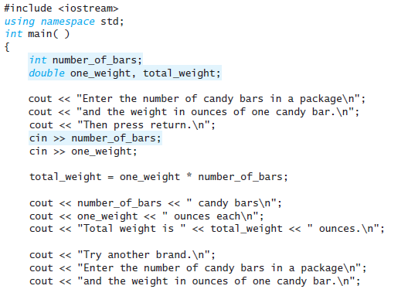
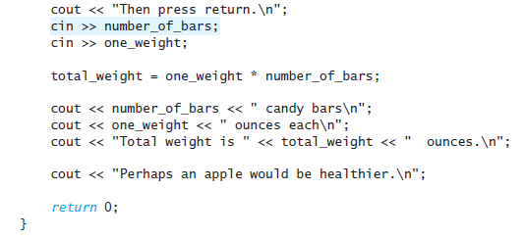
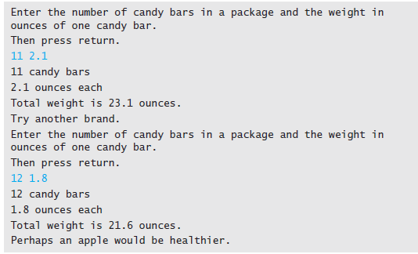
Variables and Assignments

Slide 18
Variables and Assignments
An identifier must start with either a letter or the underscore symbol, and all the rest of the characters must be letters, digits, or the underscore symbol.
C++ is a case-sensitive language; that is, it distinguishes between uppercase and lowercase letters in the spelling of identifiers.
Hence the following are three distinct identifiers and could be used to name three distinct variables:
rate RATE Rate

Slide 19
Variables and Assignments
Variable Declarations
When you declare a variable you are telling the compiler what kind of data you will be storing in the variable.
For example, the following two declarations declare the three variables used in that program:
int number_of_bars;
double one_weight, total_weight;

Slide 20
Input and Output
Output Using cout
The values of variables as well as strings of text may be output to the screen using cout.
Consider the following line from the program:
cout << number_of_bars << " candy bars\n";
This statement tells the computer to output two items: the value of the variable number_of_bars and the quoted string " candy bars\n".
You can simply list all the items to be output preceding each item to be output with the arrow symbols <<.
The arrow notation << is often called the insertion operator.
The entire cout statement ends with a semicolon.

Slide 21
Input and Output
Include Directives and Namespaces
We have started all of our programs with the following two lines:
#include <iostream>
using namespace std;
These two lines make the library iostream available. This is the library that includes, among other things, the definitions of cin and cout.
The following line is known as an include directive. It “includes” the library iostream in your program so that you have cin and cout available:
#include <iostream>

Slide 22
Input and Output
Include Directives and Namespaces
C++ divides names into namespaces.
A namespace is a collection of names, such as the names cin and cout.
A statement that specifies a namespace in the way illustrated by the following is called a using directive.
using namespace std;
This particular using directive says that your program is using the std (“standard”) namespace.
This means that the names you use will have the meaning defined for them in the std namespace

Slide 23
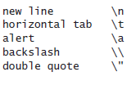
Input and Output
Escape Sequences
The backslash, \, preceding a character tells the compiler that the character following the \ does not have the same meaning as the character appearing by itself.
Such a sequence is called an escape sequence.

Slide 24
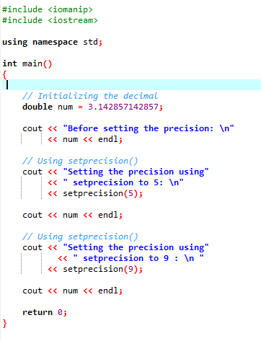

Input and Output
Formatting for Numbers with a Decimal Point

Slide 25


Input and Output
Input Using cin
You use cin for input more or less the same way you use cout for output.
The syntax is similar, except that cin is used in place of cout and the arrows point in the opposite direction.

Slide 26
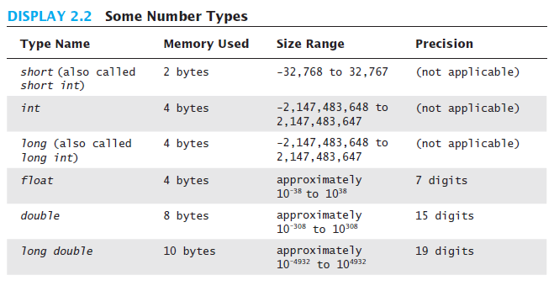
Data Types

Slide 27
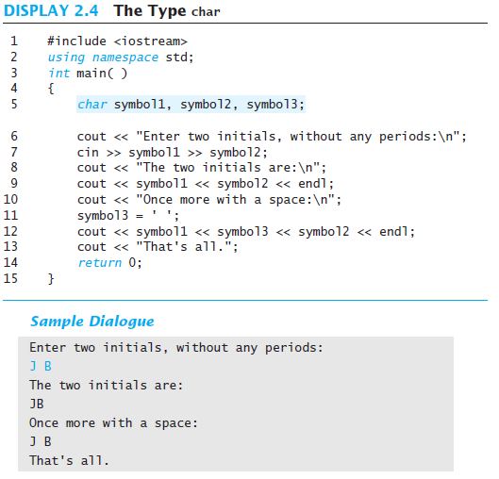
Data Types

Slide 28
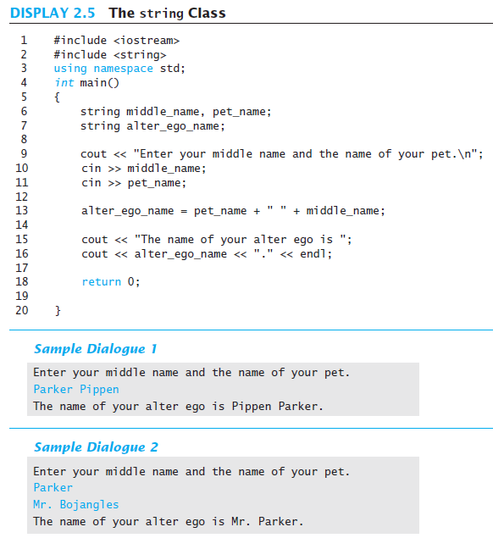
Data Types
Introduction to the Class string
To use the string class we must first include the string library:
#include <string>
You declare variables of type string just as you declare variables of types int
or double.
For example, the following declares one variable of type string
and stores the text "Monday" in it:
string day;
day = "Monday";

Slide 29
Define a class to represent a bank account. Include the following members
Data Members
Name of the depositor, Account number , Balance amount in the account
Member Function
To deposit an amount
To withdraw an amount after checking the balance
To display name and balance.
Write a class named Vehicle that can represent both the Rickshaw and Bike. Each vehicle has the following details:
year. An int that holds the vehicle’s model year.
manufacturer. A string that holds the manufacturer name of that vehicle.
speed. An int that holds the vehicle’s current speed.
Member functions.
accelerate. The accelerate function should add 5 to the speed member variable each time it is called.
brake. The brake function should subtract 5 from the speed member variable each time it is called.
Demonstrate the class in a program that creates a Vehicle object for a Rickshaw and for a Bike, and then calls the accelerate function and call the brake function .

